Slide 1

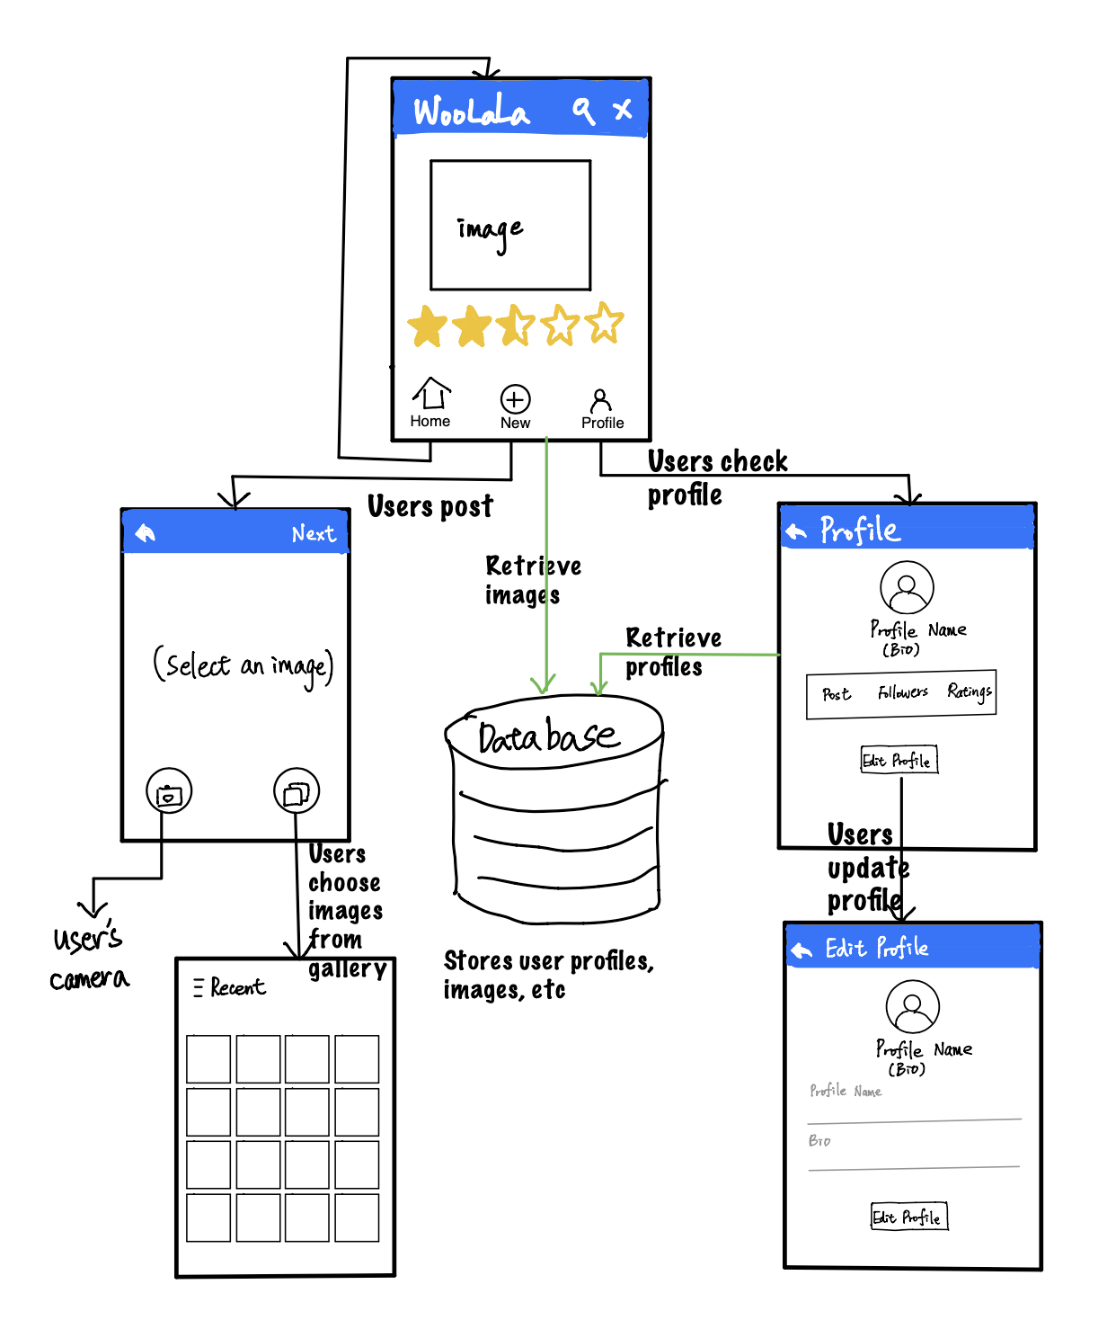
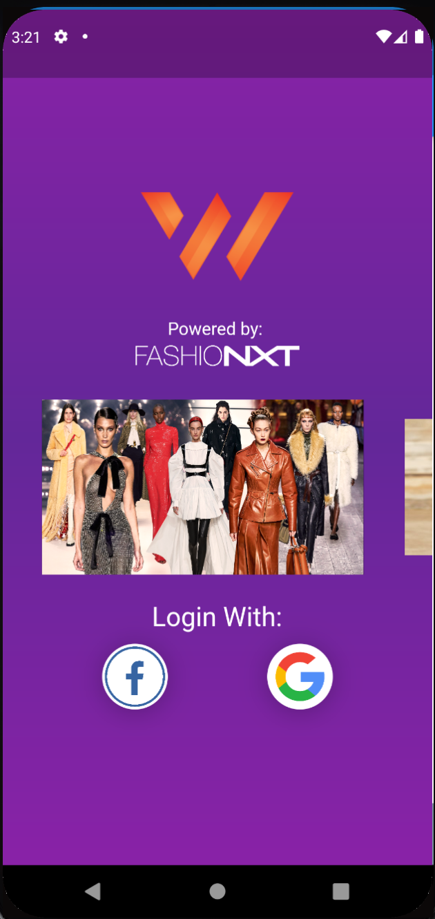
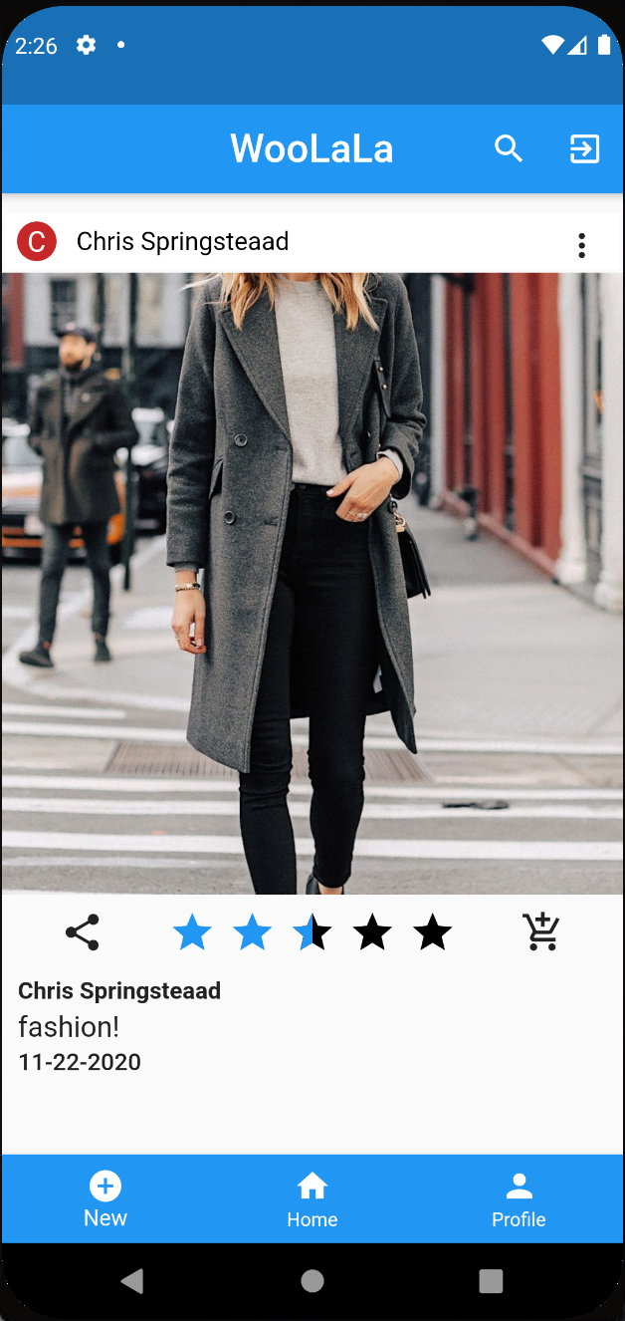
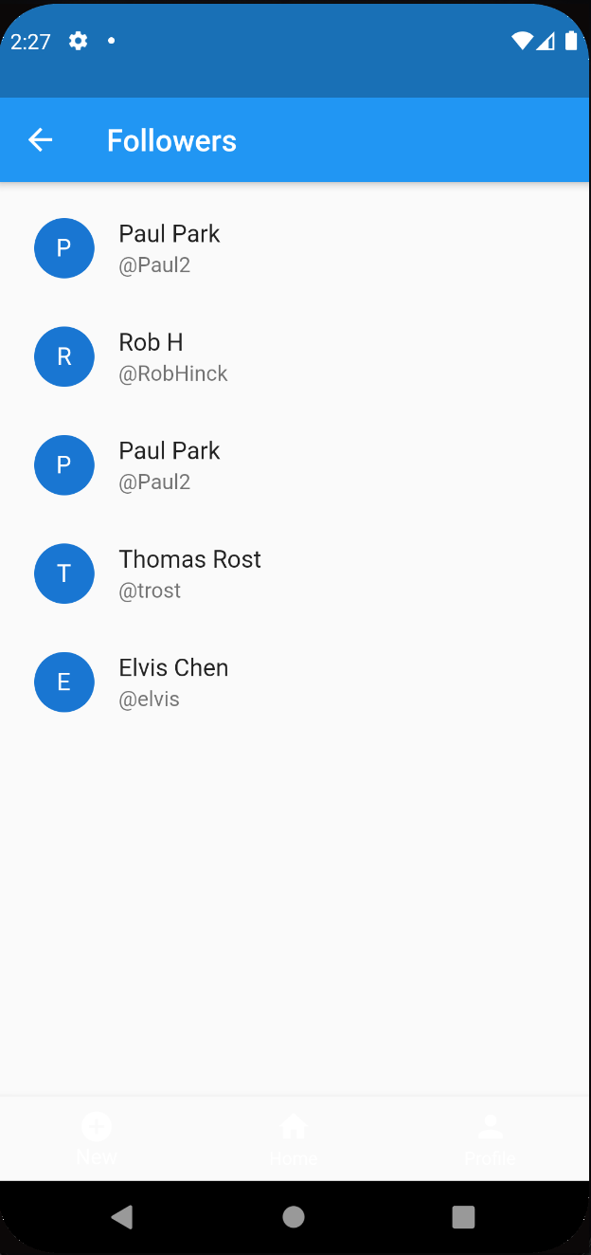
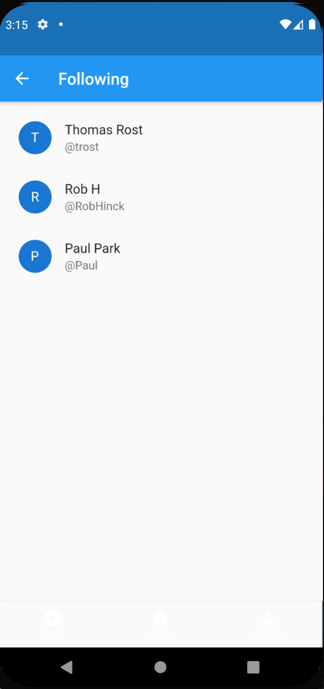
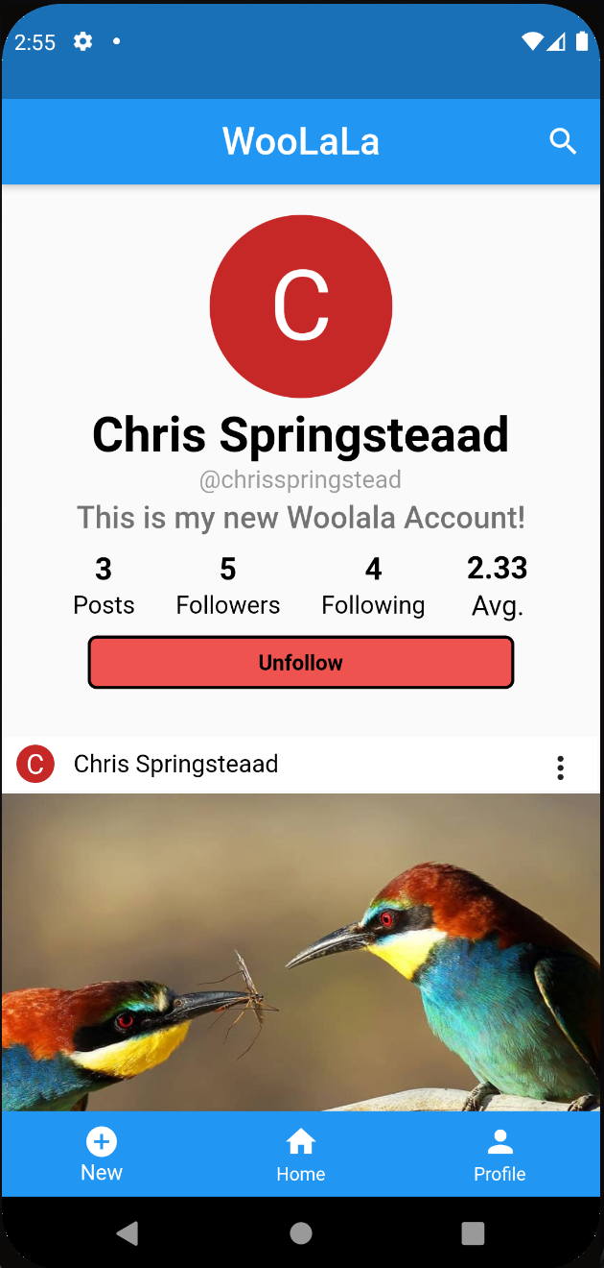
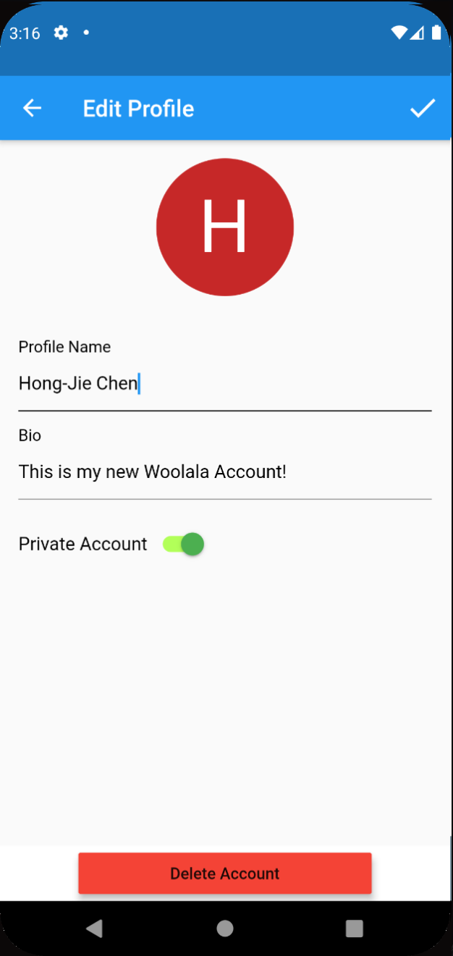
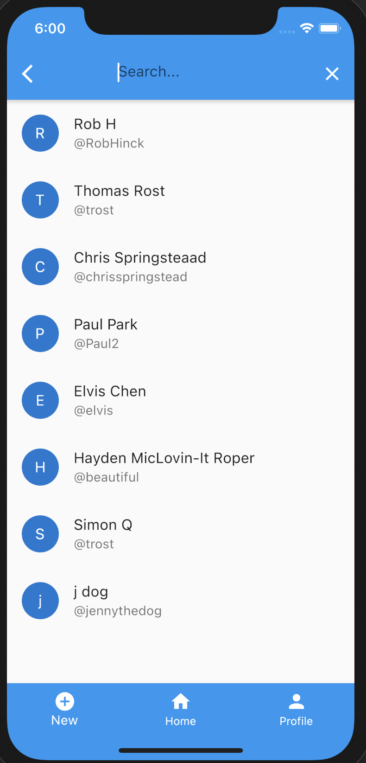
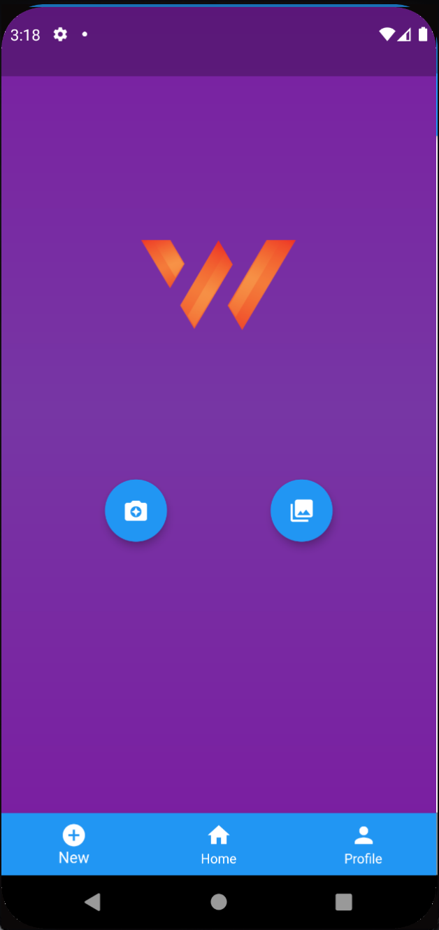
The WooLaLa Mobile Application
Hayden Roper, Thomas Rost, Robert Hinck, Chris Springstead, Deokman Park, Hong-Jie Chen and D. M. H. Walker
Dept. of Computer Science and Engineering, Texas A&M University
Introduction
Design Diagram
The WooLaLa mobile application is a tool that our customer would like to have to help them identify aggregate likeability of certain creative content. WooLaLa is expected to be an image sharing and rating system, where users can not only upload images from their devices or camera but also rate posts from other users. Users are also allowed to show their interest in buying a product from a post. The user can also share a post to their Facebook account.
Customer Expectations
A social media app that:
Revolves around rating Visual Experiences.
Takes UX elements from apps like Instagram, Tinder, and Yelp and puts it into one place to create a holistic experience
Will help identify major visual trends and give users quantitative feedback about their content
Development Environment
Development Kit: Flutter
IDE & Emulator: Android Studio/XCode + built-in emulator
Database: MongoDB
Backend Server: Node.js
Programming Language: Dart
The WooLaLa Mobile Application
Features
Login Page
Home Page
Followers Page
Following Page
Log in: Users can log in the app via their Google or Facebook account by clicking an icon.
Create/Edit Profile
Search/Follow Users
Post Feed: Users can see the posts from the users they are following
Create/Delete Posts: Users can make posts by uploading/taking pictures and adding a caption, as well as delete them
Rate Other’s Posts: Users can rate the posts on their feed by sliding from 0 to 5 stars
View Average Post Score
Share post to Facebook
Show interest in buying post content
Report Posts
Profile Page
Profile Editing Page
Search Page
Posting Page
Future Work
Push Notifications: Users receive notifications when someone wants to buy their post or someone direct messages them
Direct Message Users can send message to others
Buy from post: Users can buy the item from the post directly by a button click
Image filter: Users can use filters on the image before they post the image
Acknowledgement
The work was done with the support of the professor Dr. Walker and our customer Mr. Chowdhury. Special thanks to technical lead Mr. Ashfaq for his suggestions.

